Slide 1


Flight Price Prediction
By
Manoj.I.V
Fliprobo Technologies
Datatrained

Slide 2
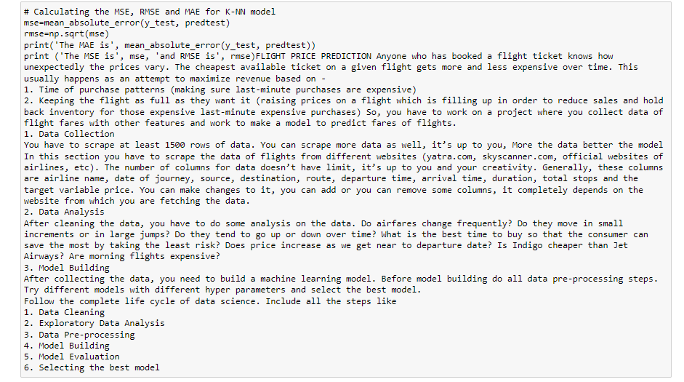
Problem Statement

Slide 3
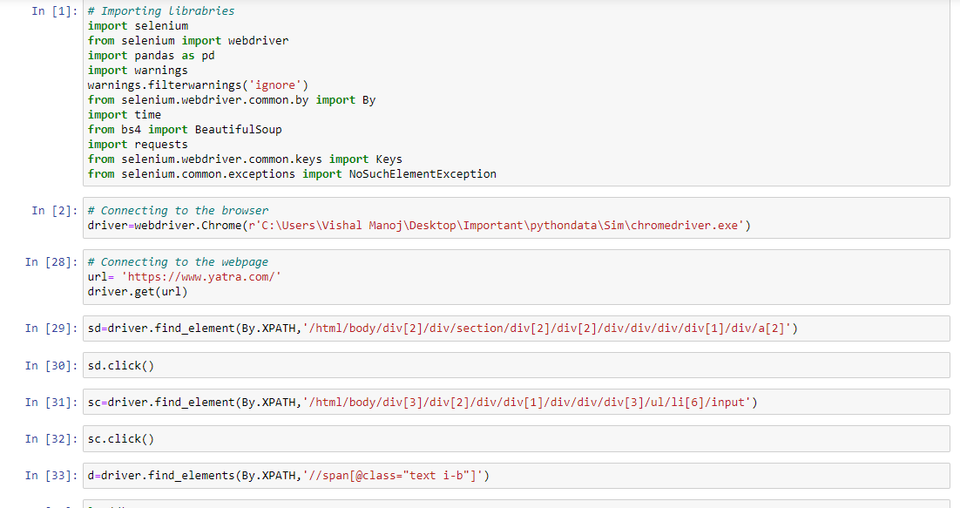
Data Collection (Web scrapping)

Slide 4
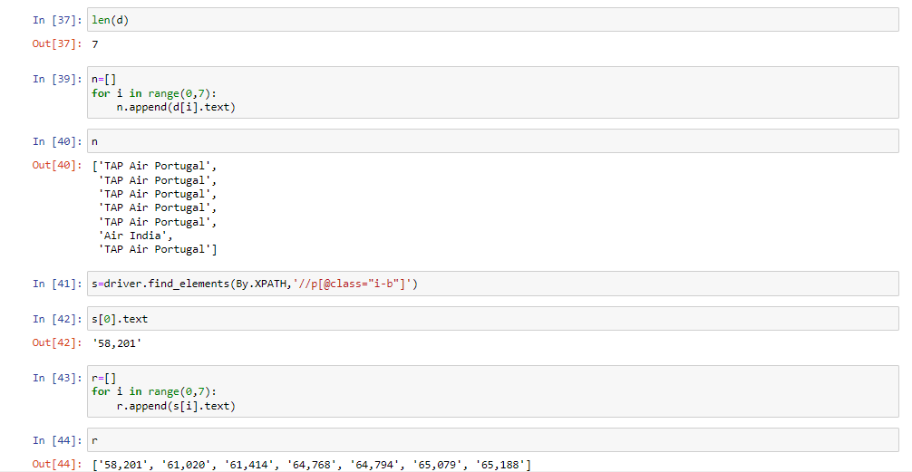
Data Collection (Web scrapping)

Slide 5
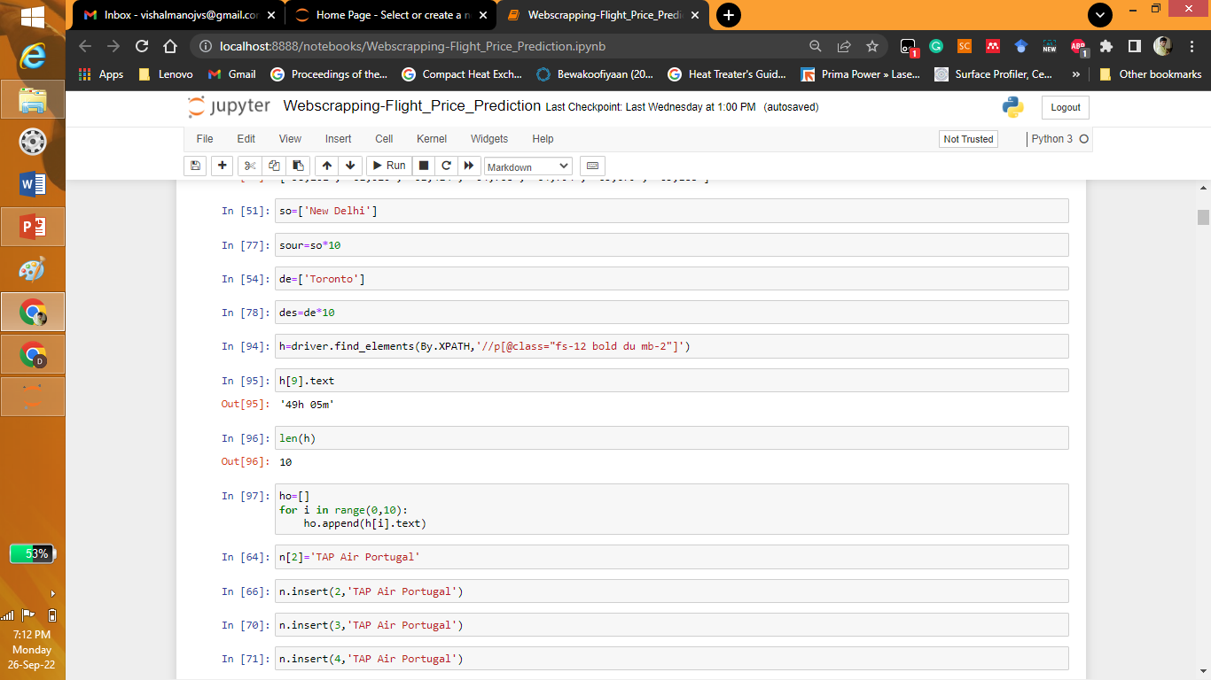
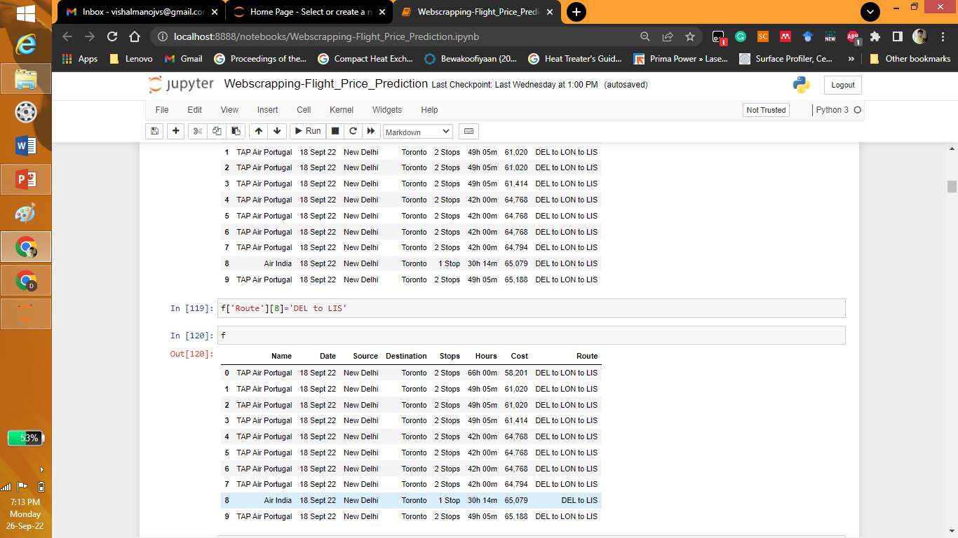
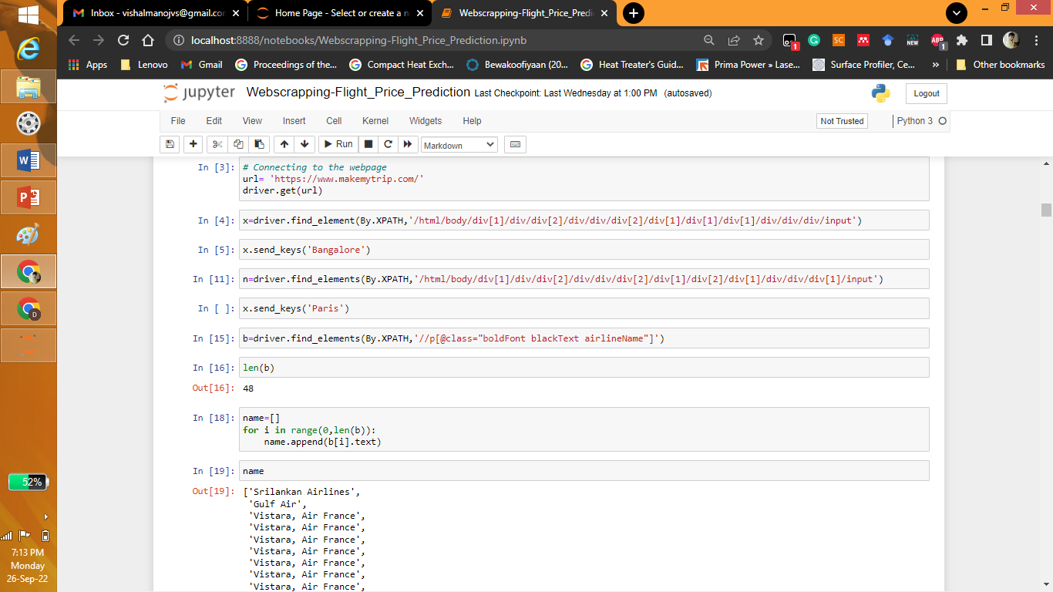
Data Collection (Web scrapping)

Slide 6
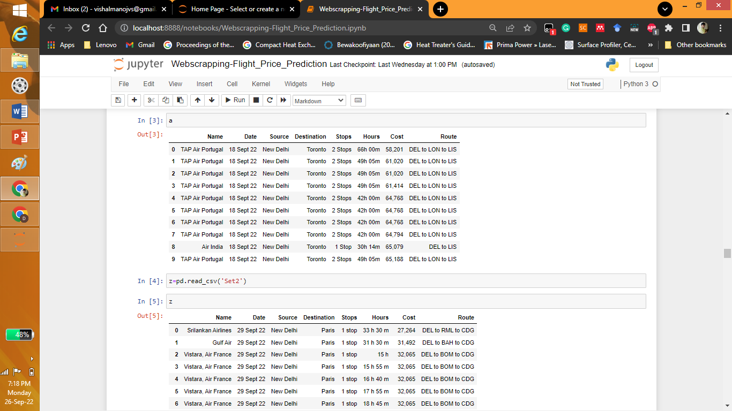
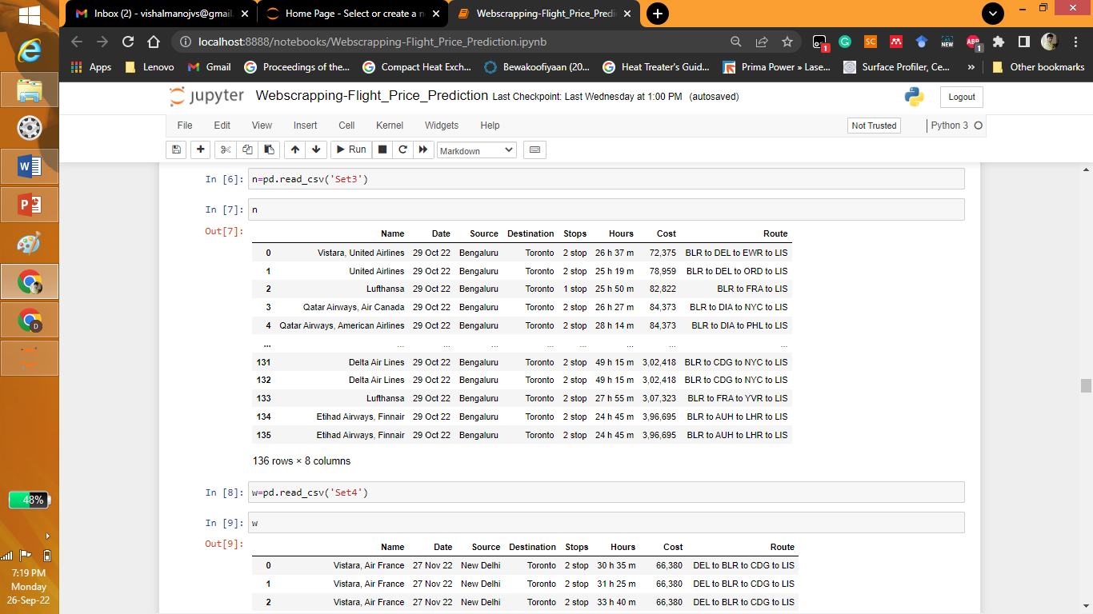
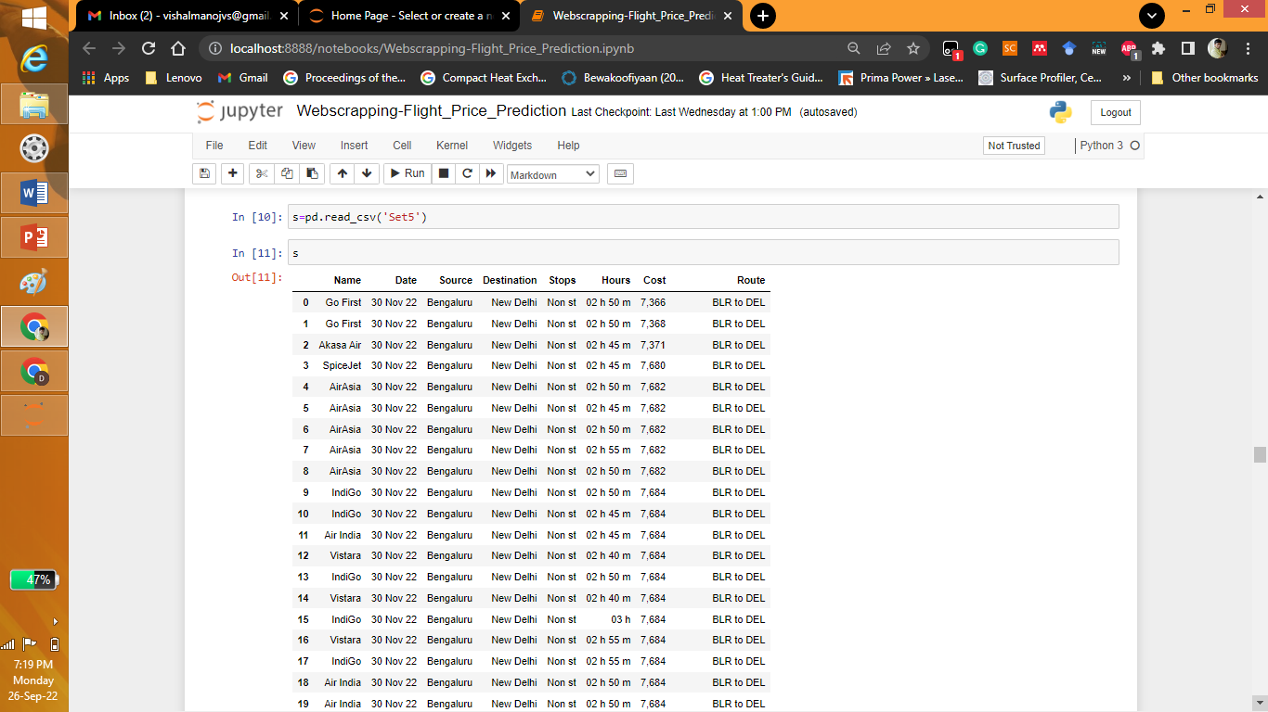
Data Collection (Web scrapping)

Slide 7
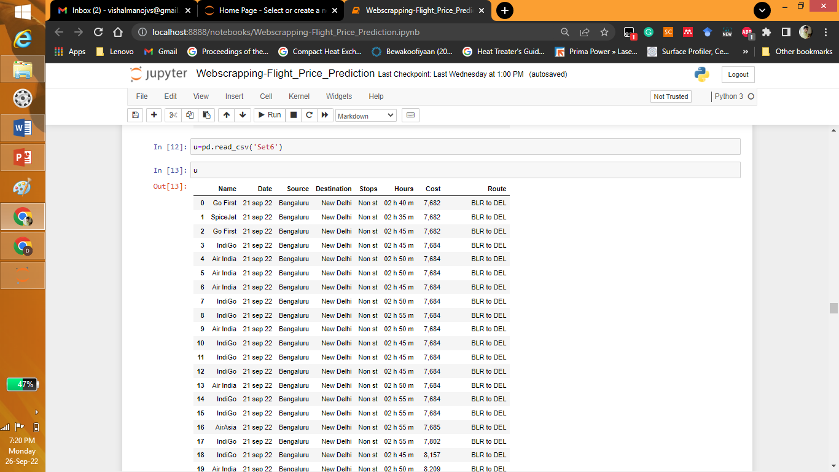
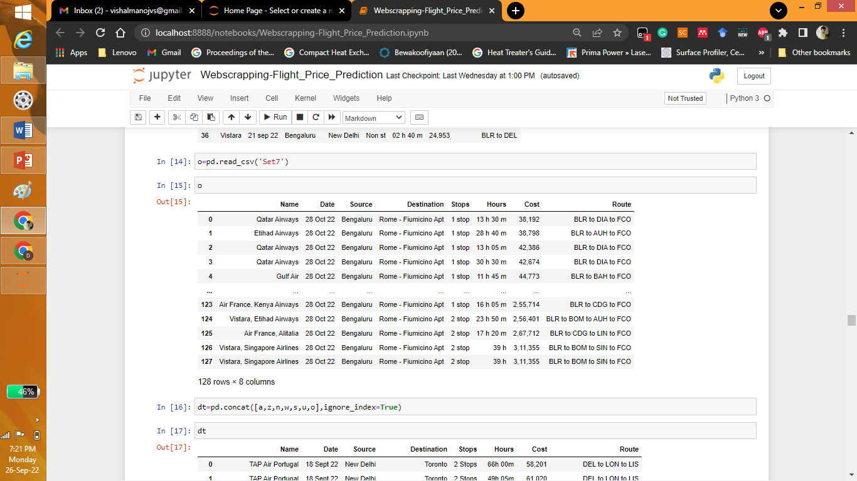
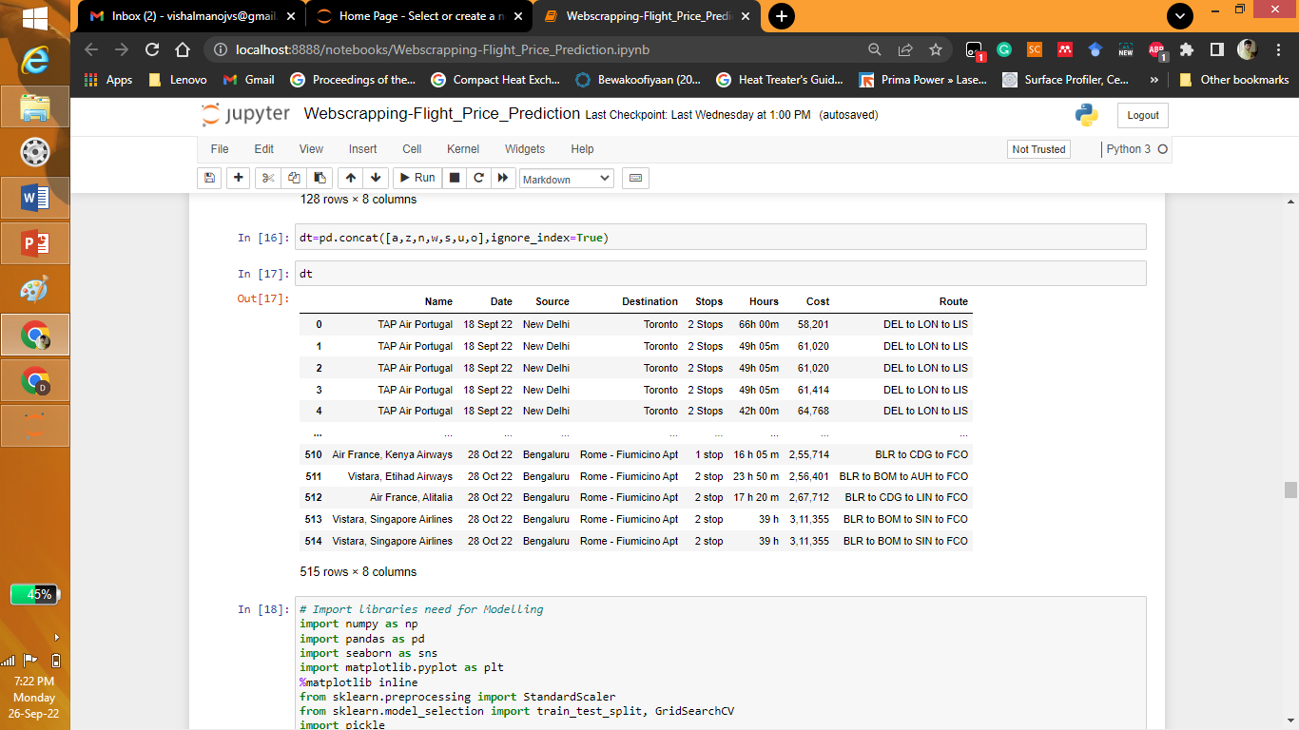
Data Collection (Web scrapping)

Slide 8
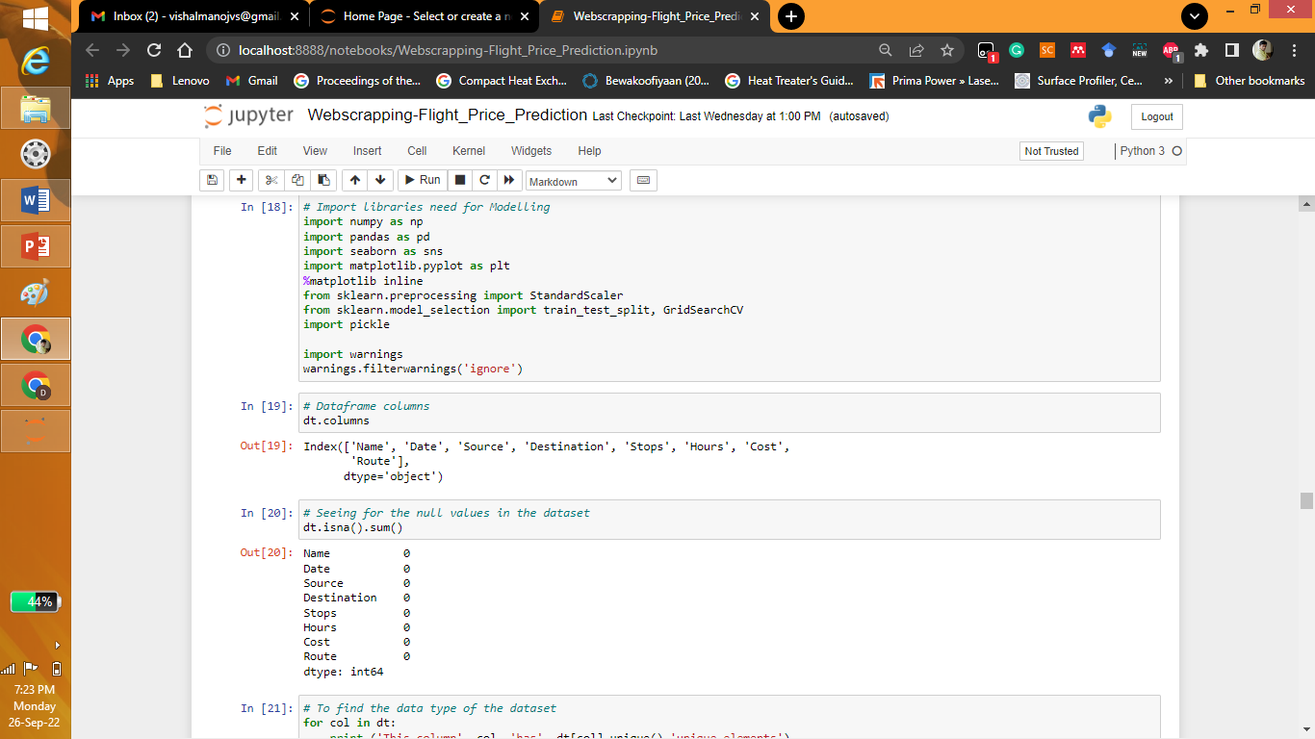
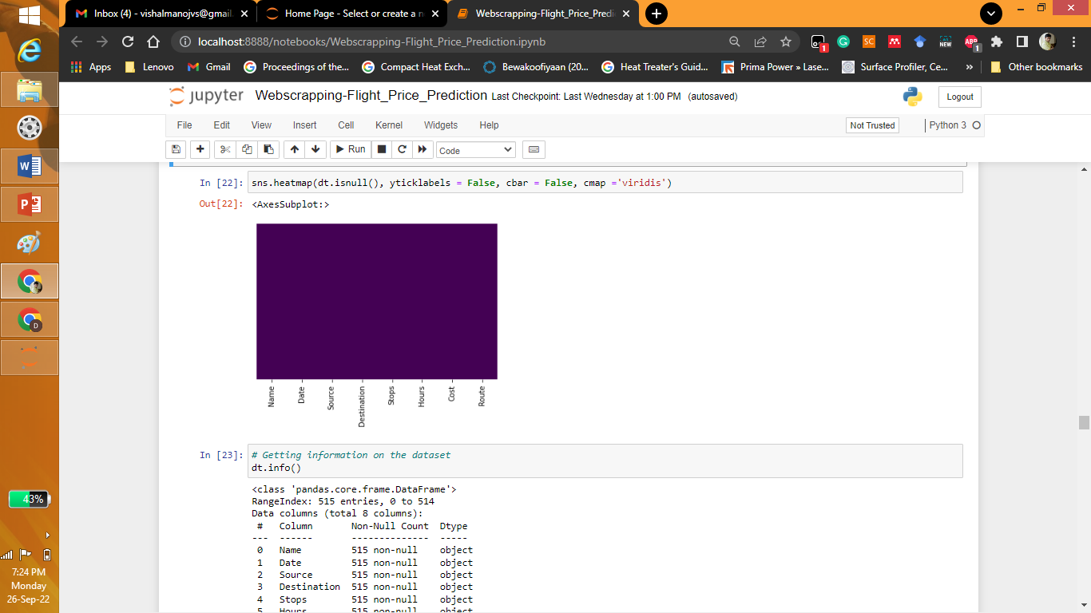

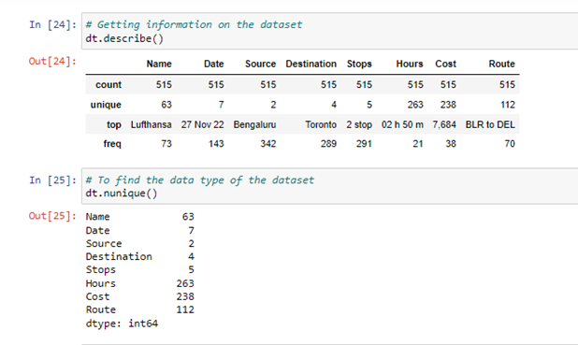
Exploring Dataset

Slide 9
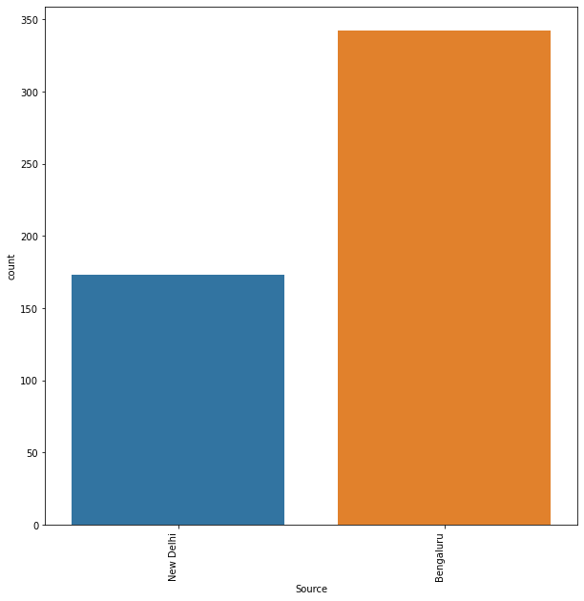
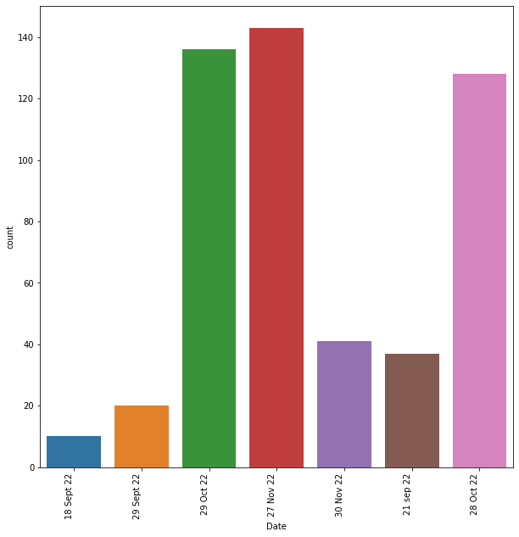
Explorative Data Analysis

Slide 10
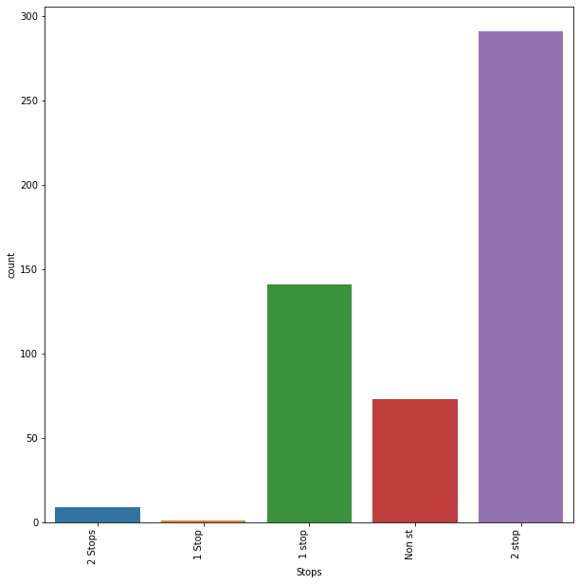
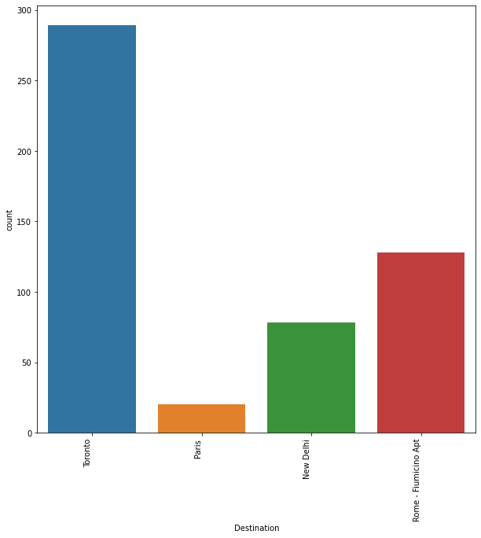
Explorative Data Analysis

Slide 11
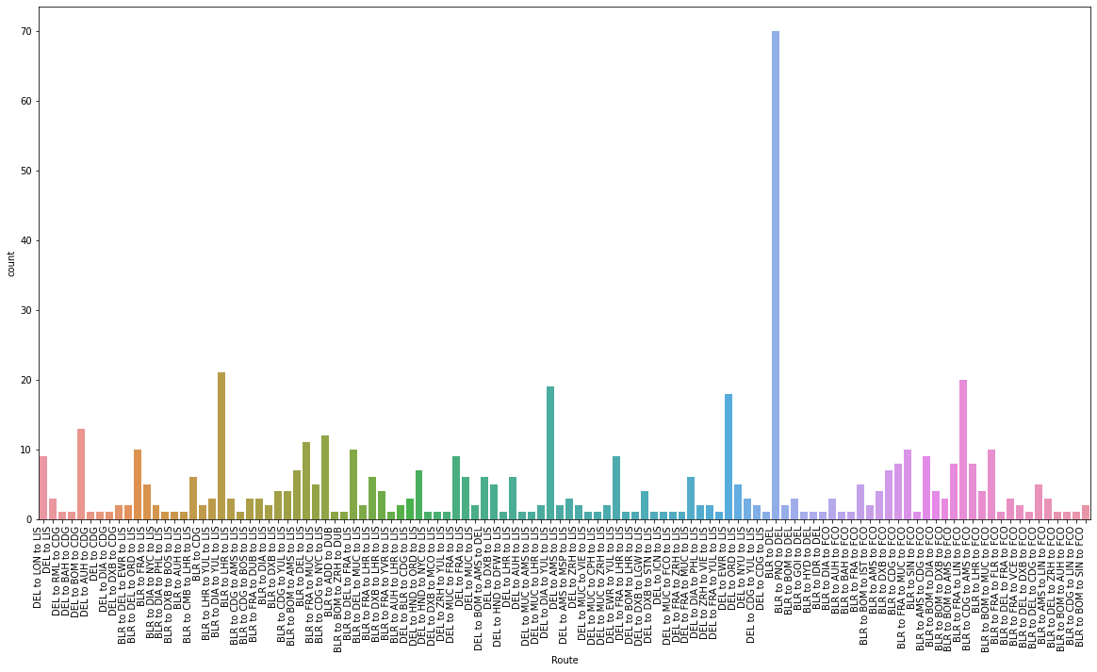
Explorative Data Analysis

Slide 12
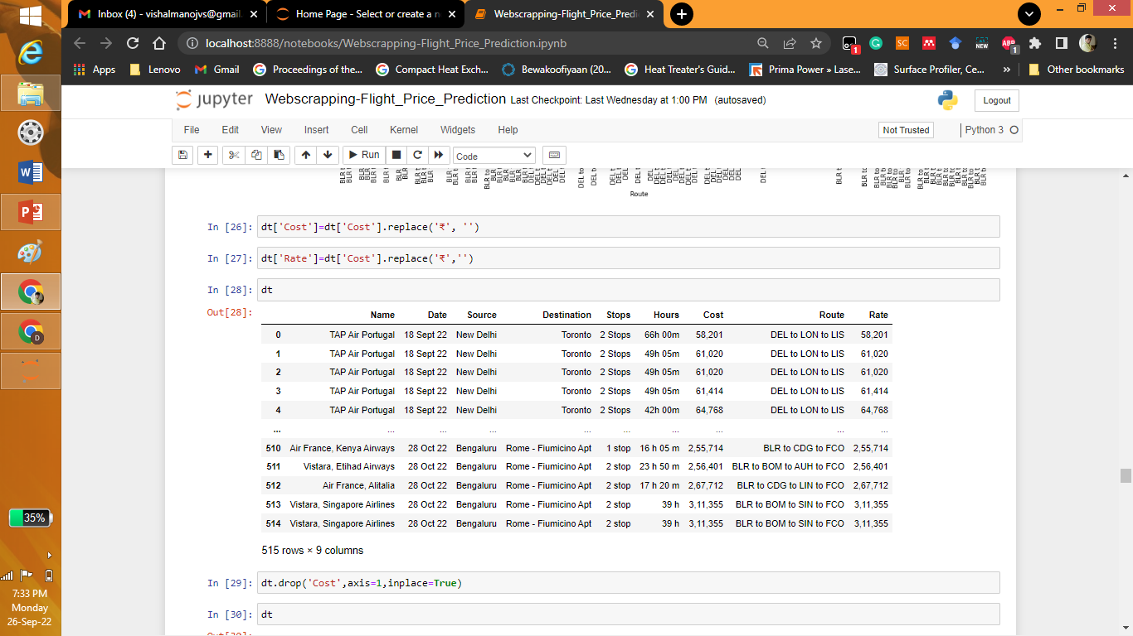

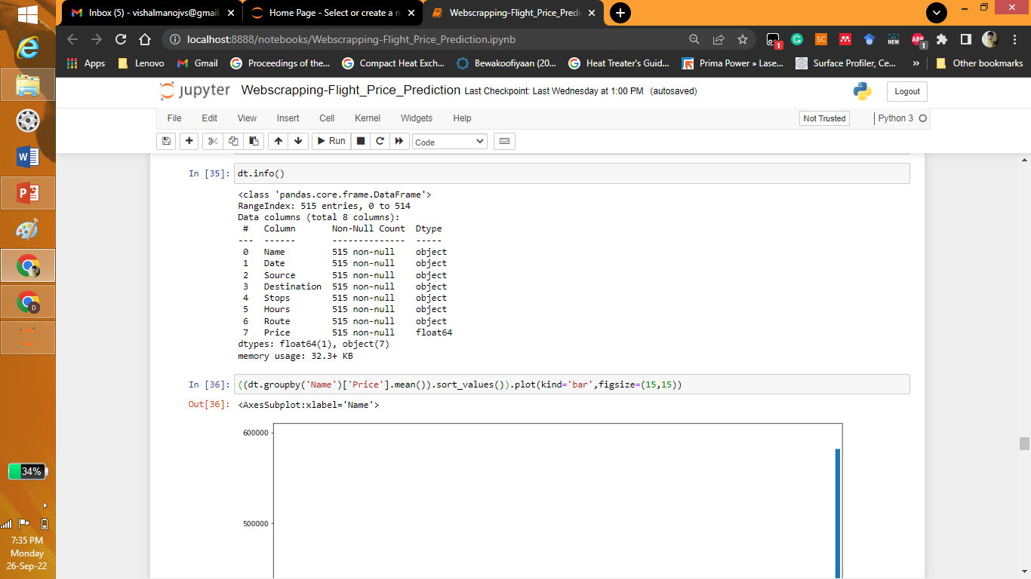
Explorative Data Analysis

Slide 13
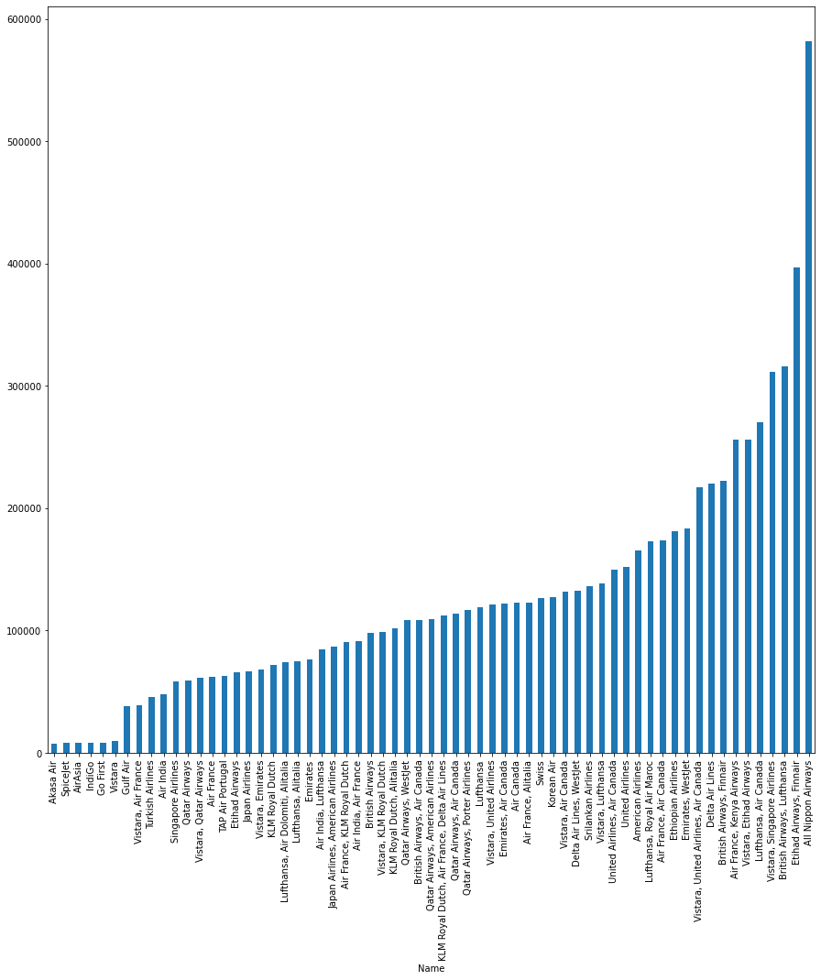
Explorative Data Analysis

Slide 14
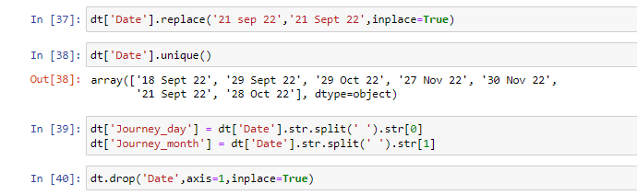
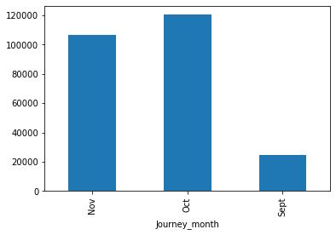
EDA and Data Cleaning

Slide 15
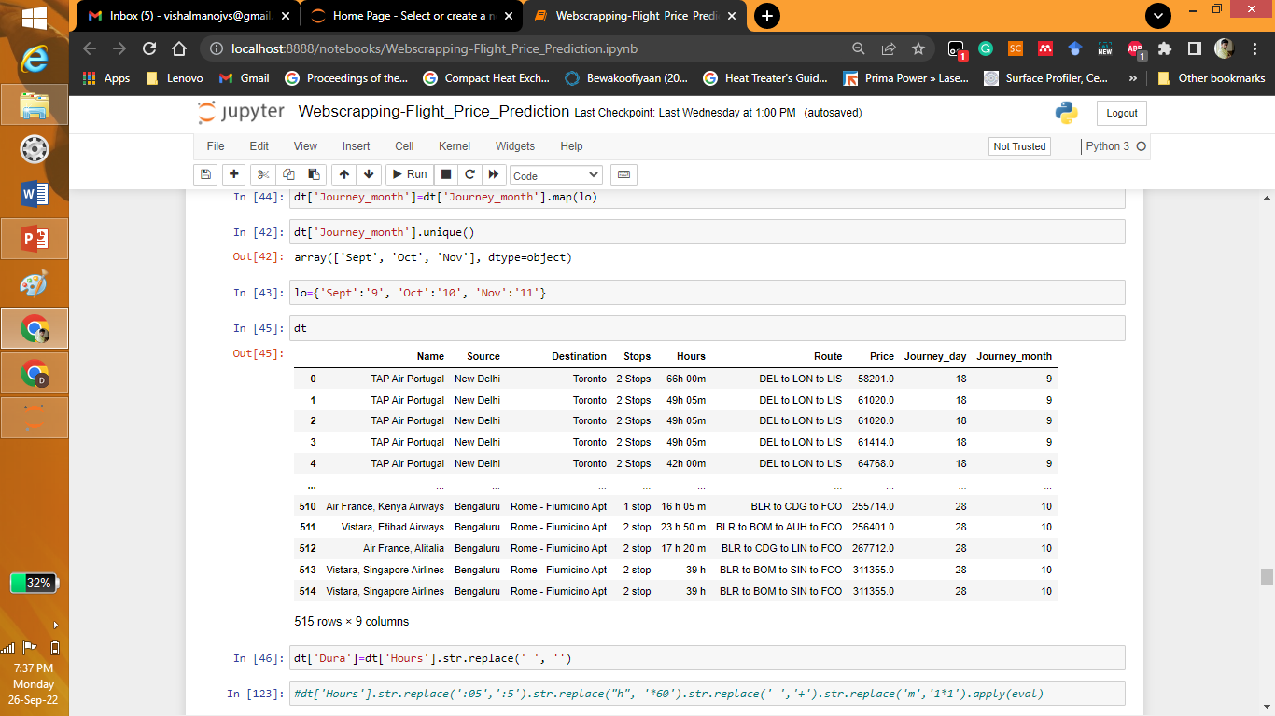
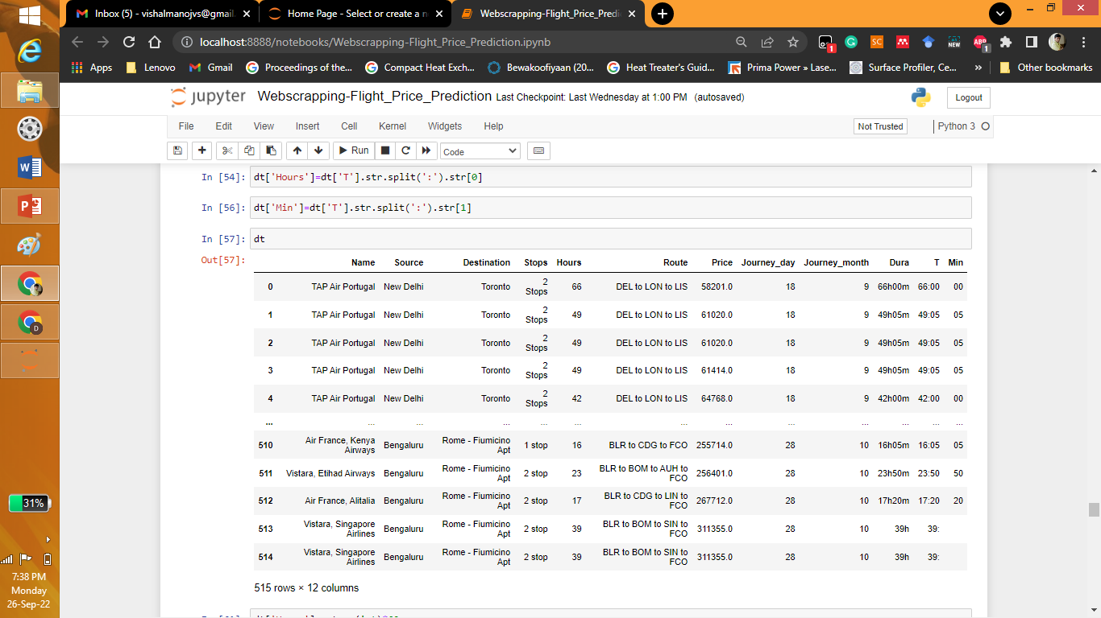
EDA and Data Cleaning

Slide 16
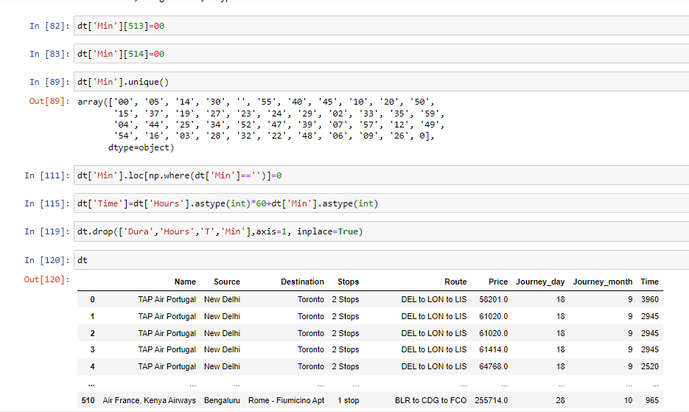
EDA and Data Cleaning

Slide 17
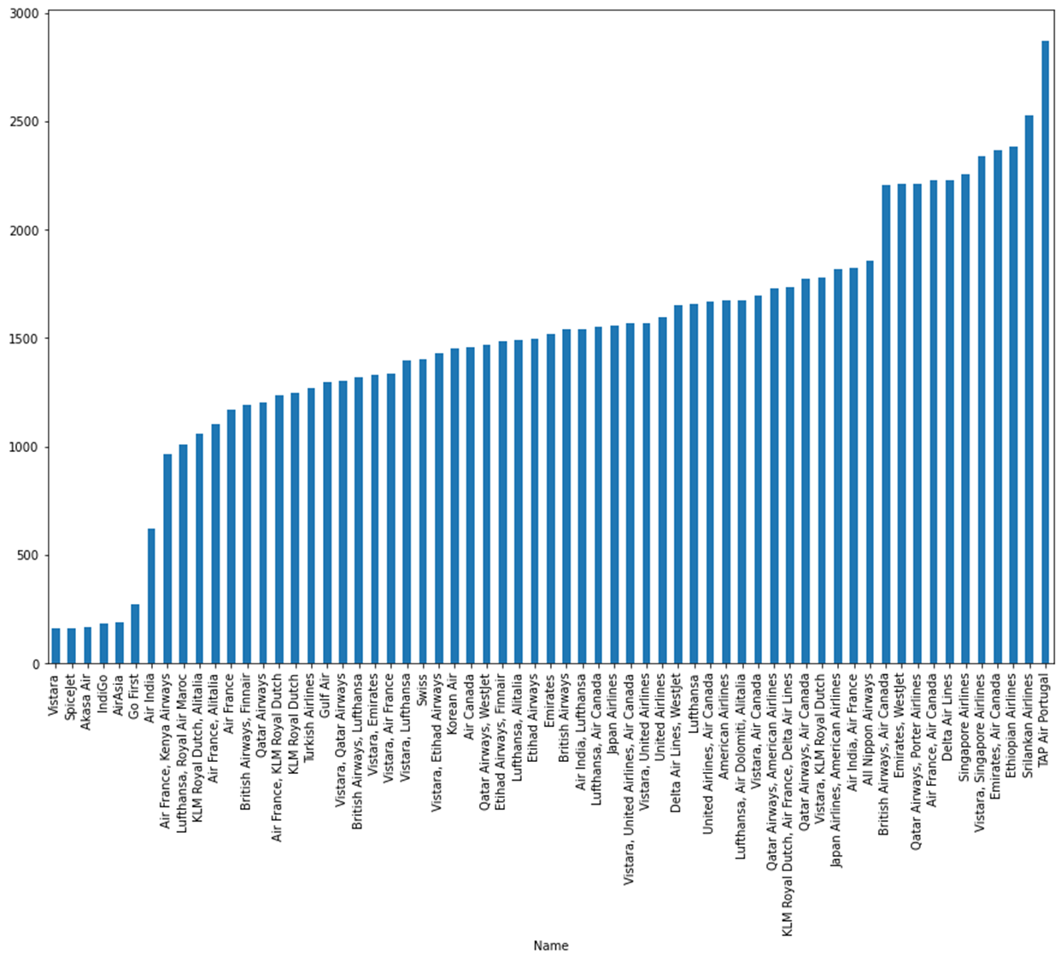
EDA and Data Cleaning

Slide 18

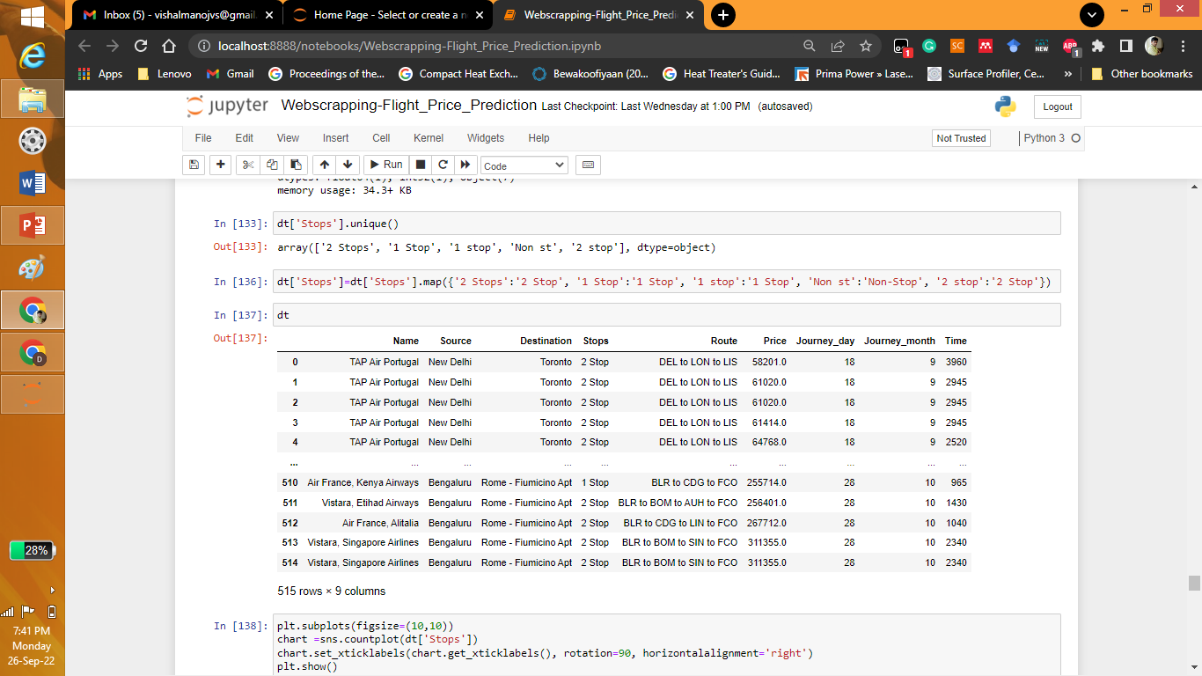
EDA and Data Cleaning

Slide 19
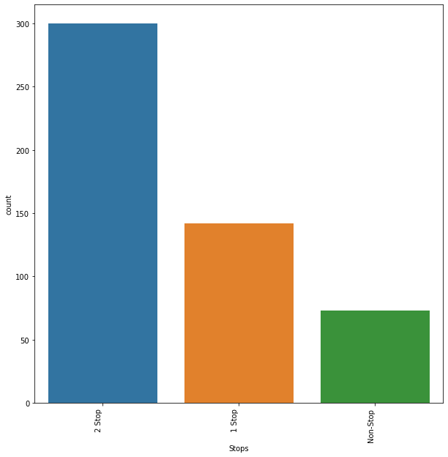
EDA and Data Cleaning

Slide 20
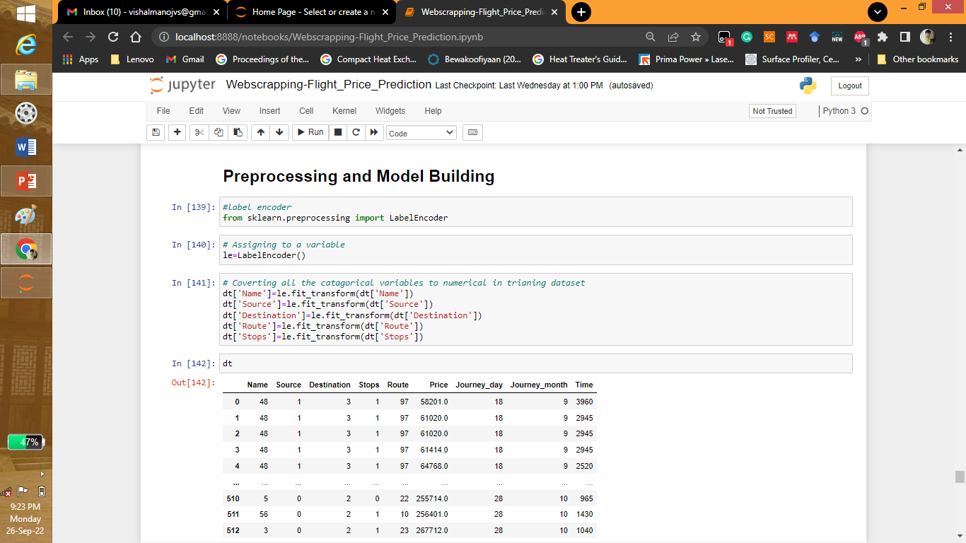
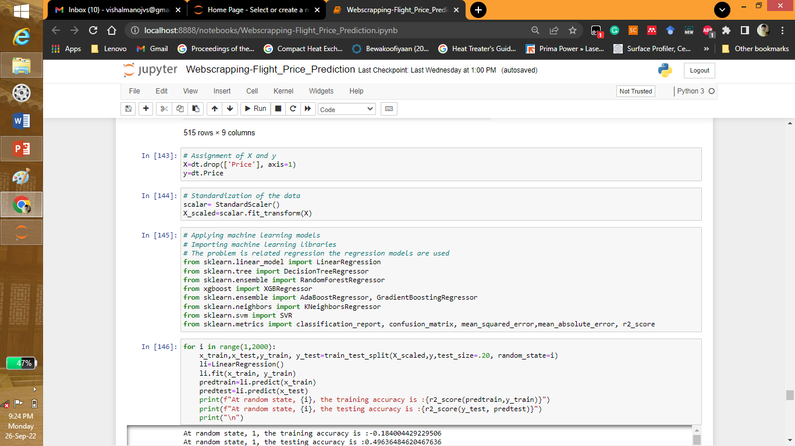
Preprocessing and Model Building

Slide 21
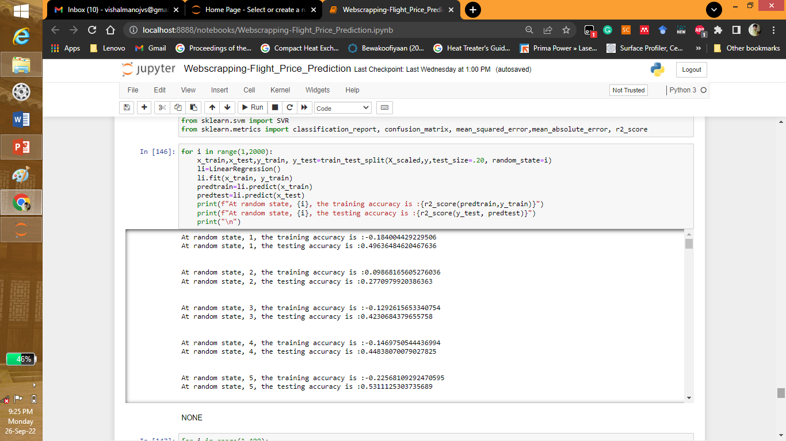
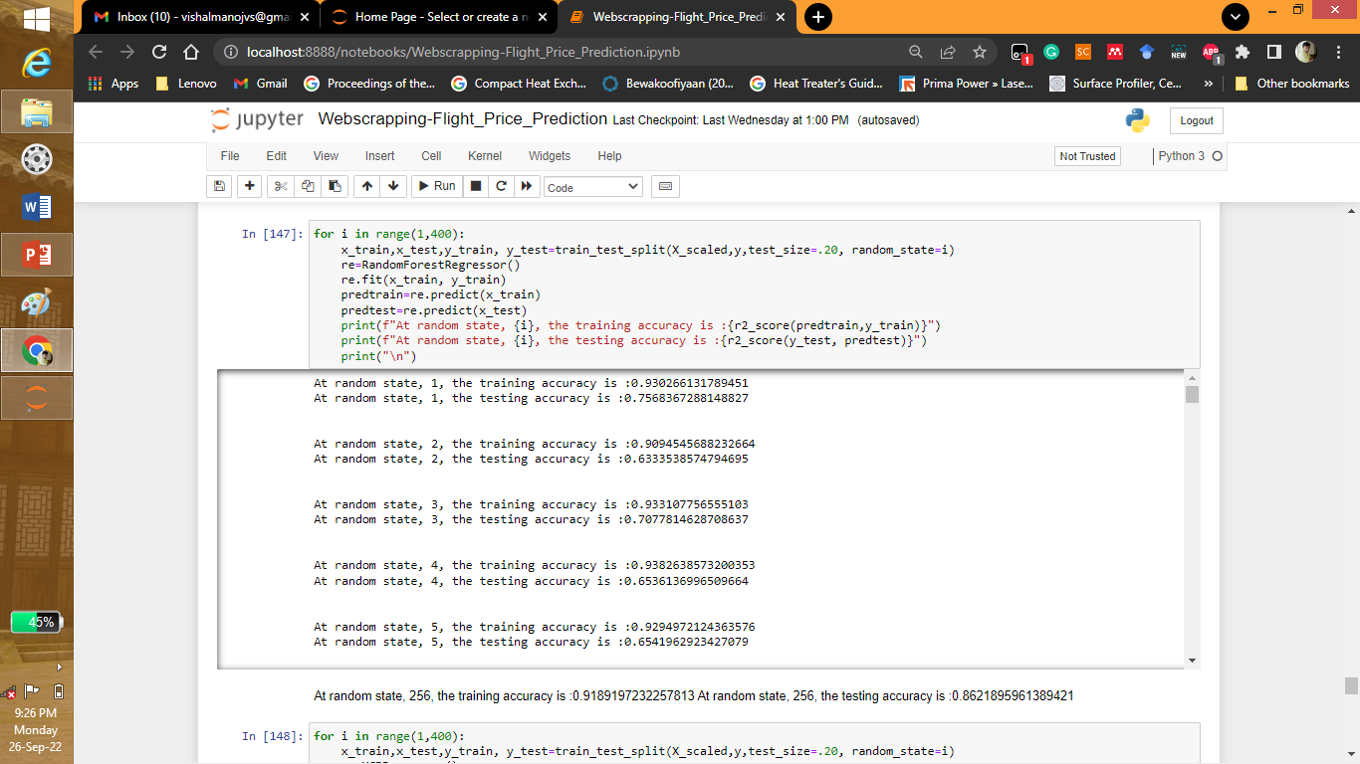
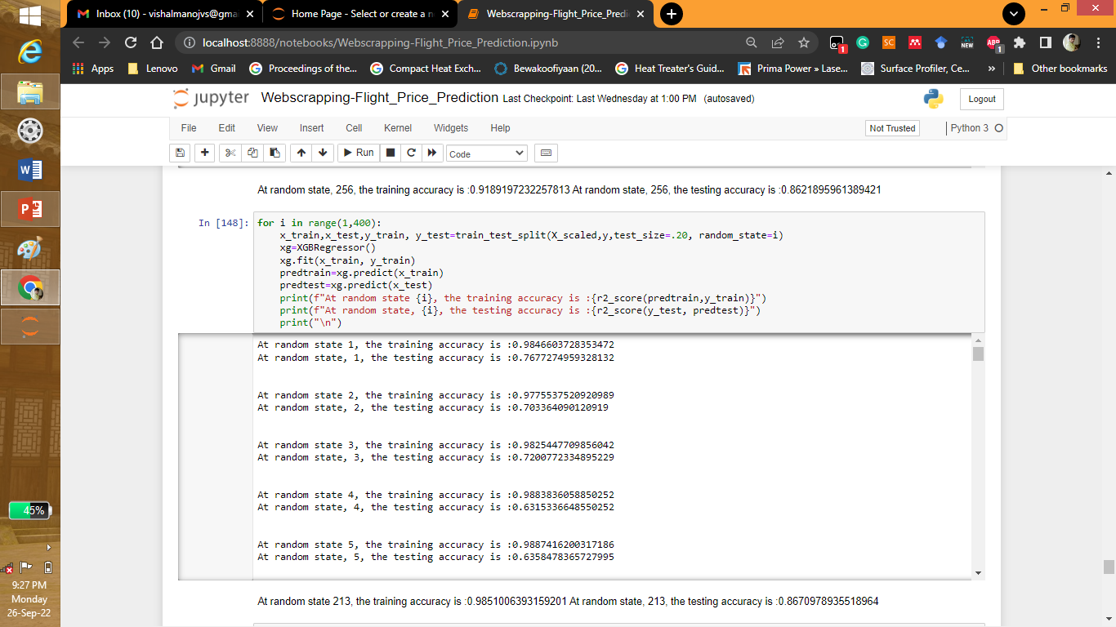
Model Building

Slide 22
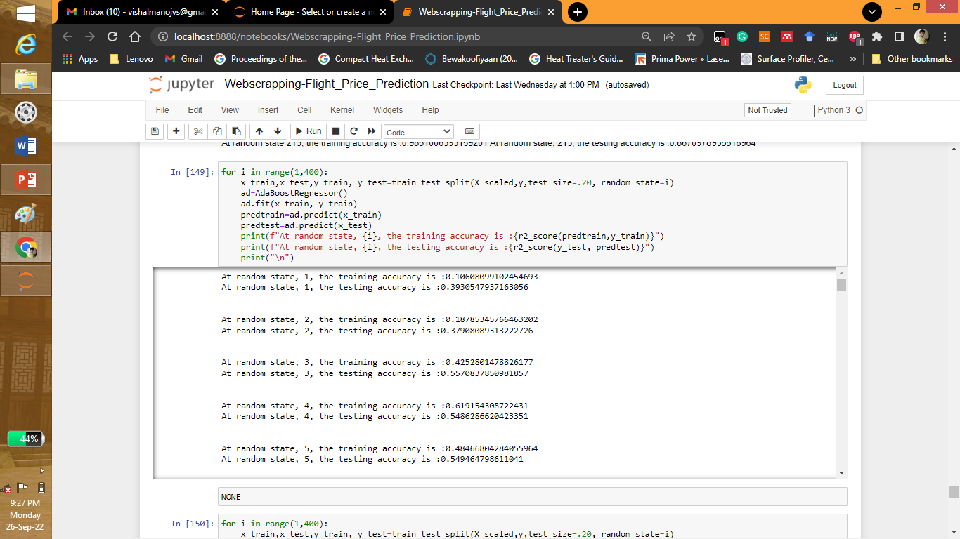


Model Building

Slide 23
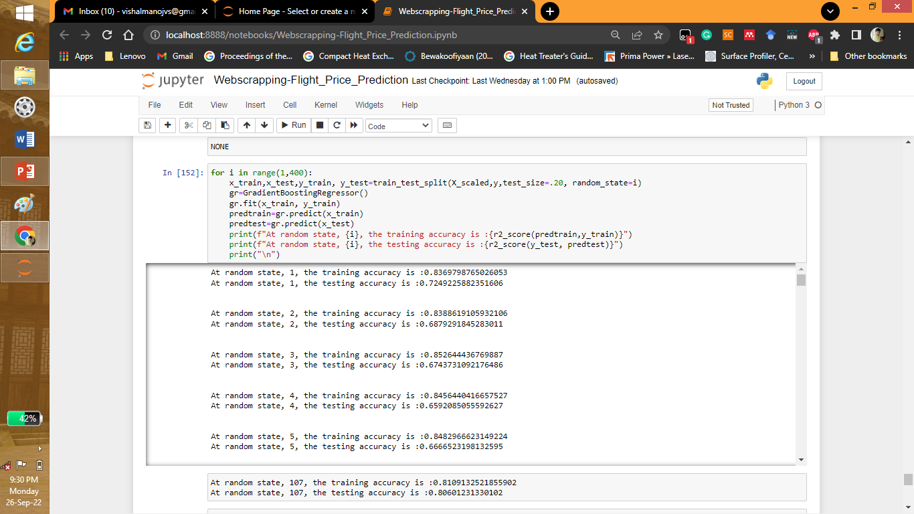
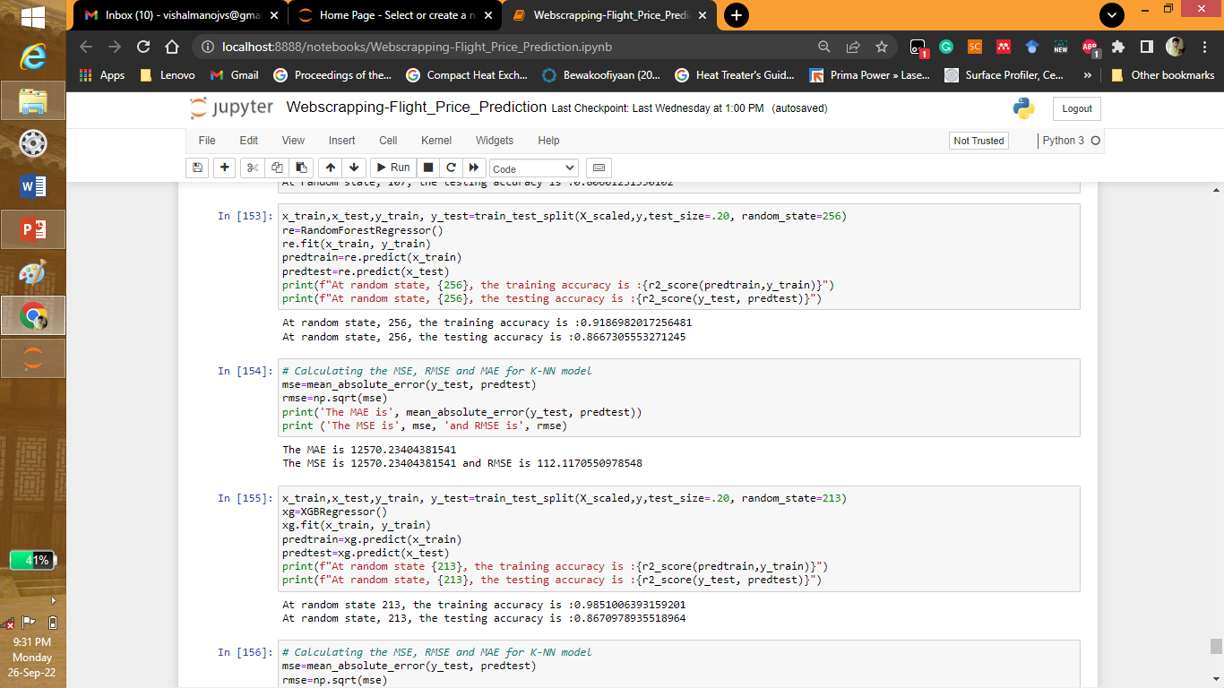
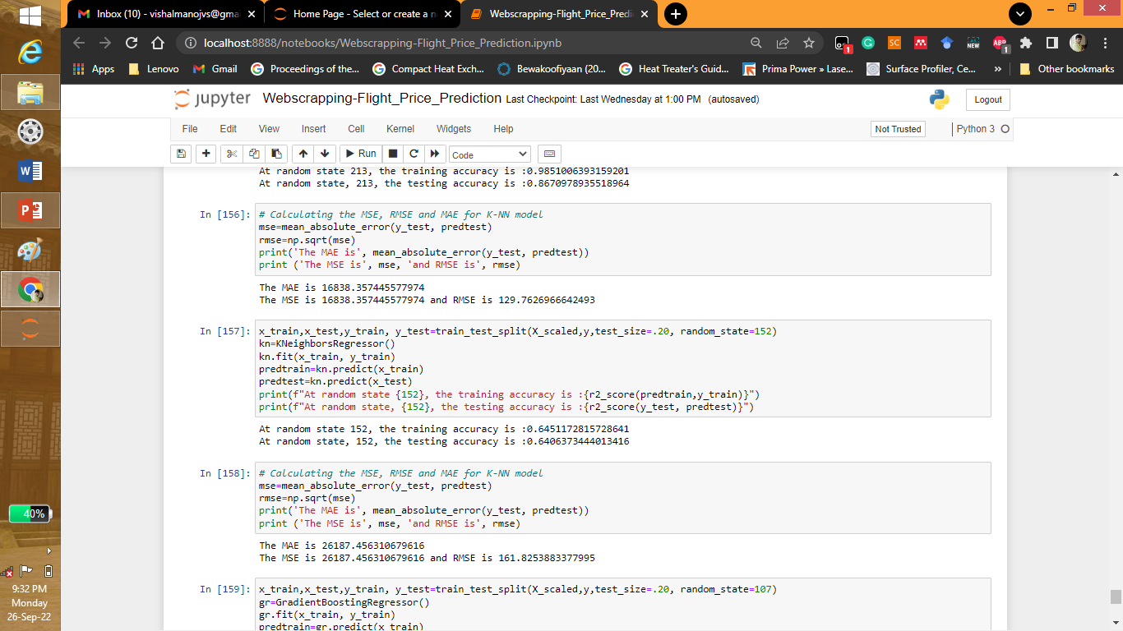
Model Building

Slide 24
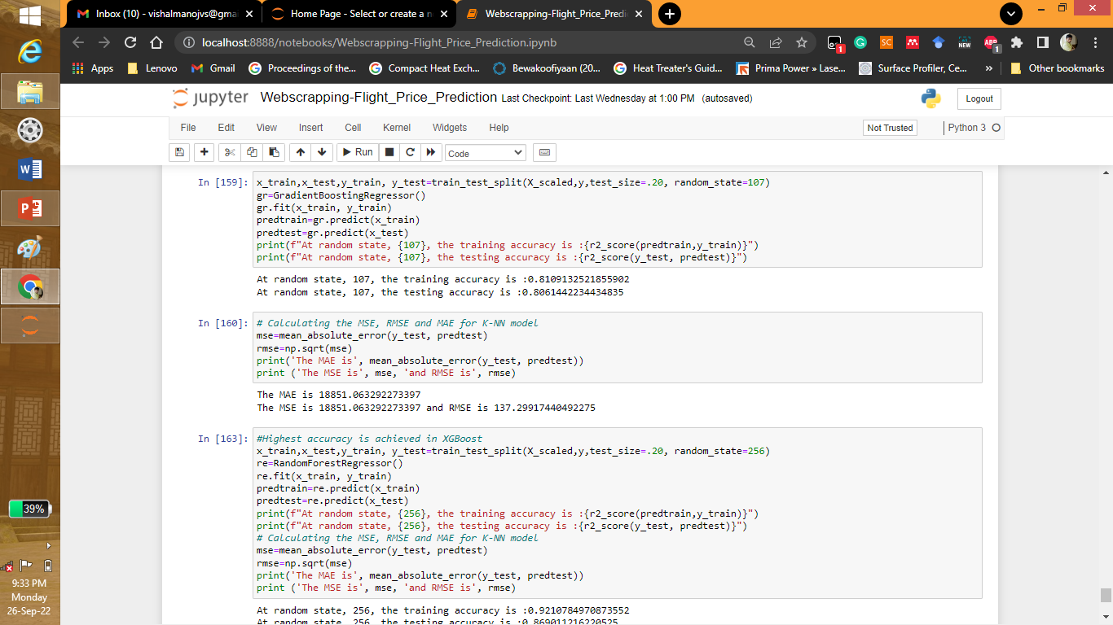

Model Building

Slide 25
Conclusion
The data was scrapped from the websites make my trip,yatra.com etc. From scrapped data different kinds of cleaning have to be done before EDA as it comes with junk data also. It was cleaned in python and different graphs were drawn.
It was seen that TAP AIR RORTUGAL was the airways having highest amount of travelling time. The month of October most travelling occurred according to the dataset. Most of them have 2 stops at least to commute. ALL NIPPON AIRWAYS is the most costliest. Most travelling occurred on 27 NOV 2022. From the dataset it was seen that TORONTO was the most destination place.
The XGBOOST gave the highest accuracy. At random state, 256, the training accuracy is :0.9210784970873552. At random state, 256, the testing accuracy is :0.869011216220525. The MAE is 12957.08145988235. The MSE is 12957.08145988235 and RMSE is 113.82917666346512.
After hyper parameter tuning it was found to have At random state, 256, the training accuracy is :0.9130650810656163. At random state, 256, the testing accuracy is :0.8812360857622321. The MAE is 12974.838366156499. The MSE is 12974.838366156499 and RMSE is 113.90714800290849

